Slide 1
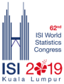

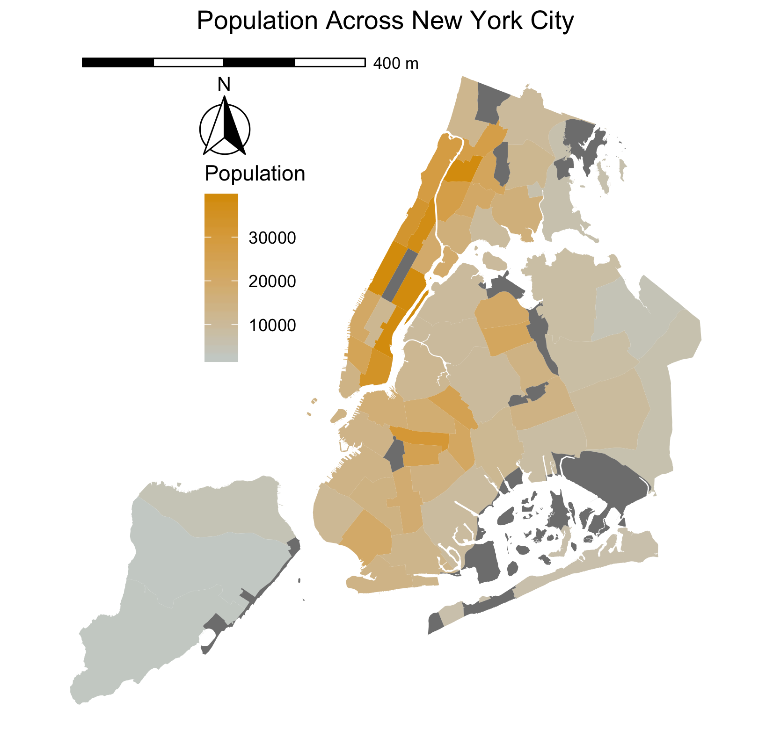
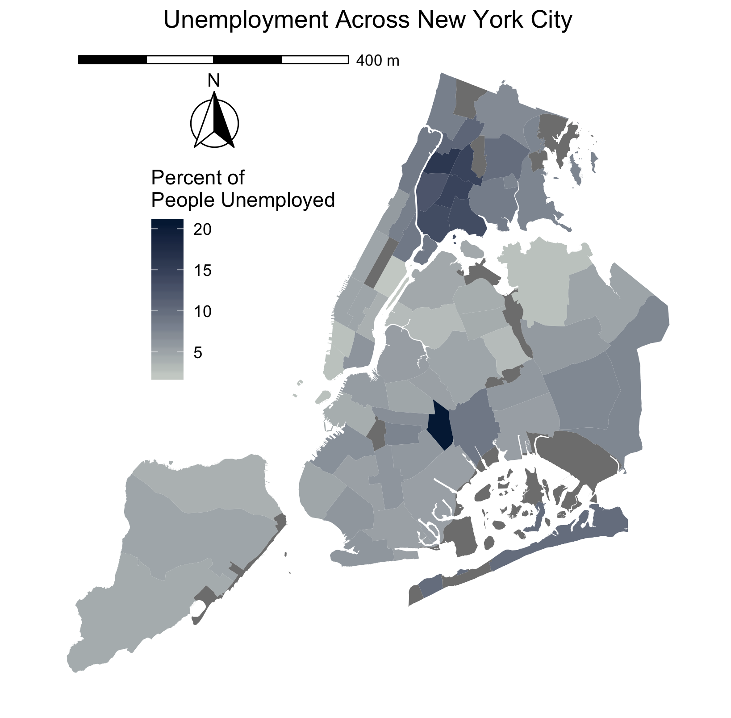

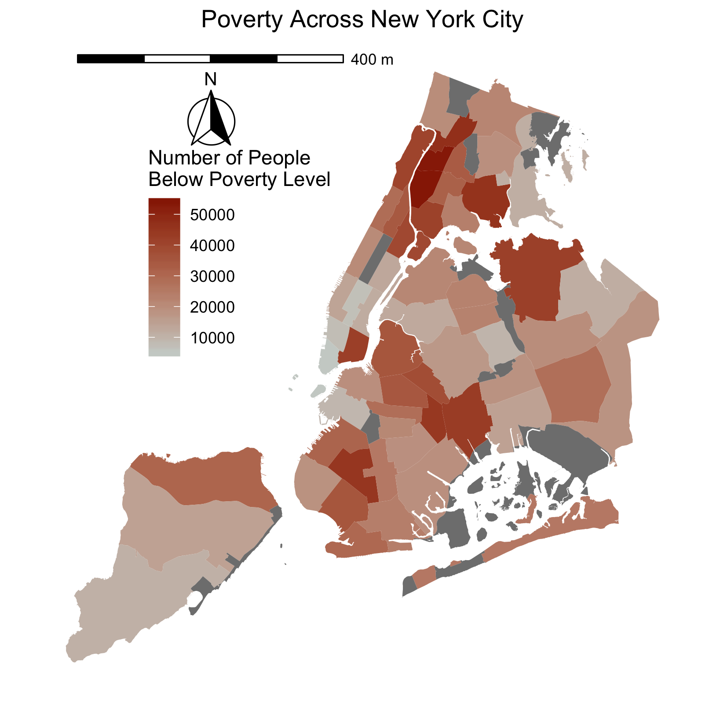
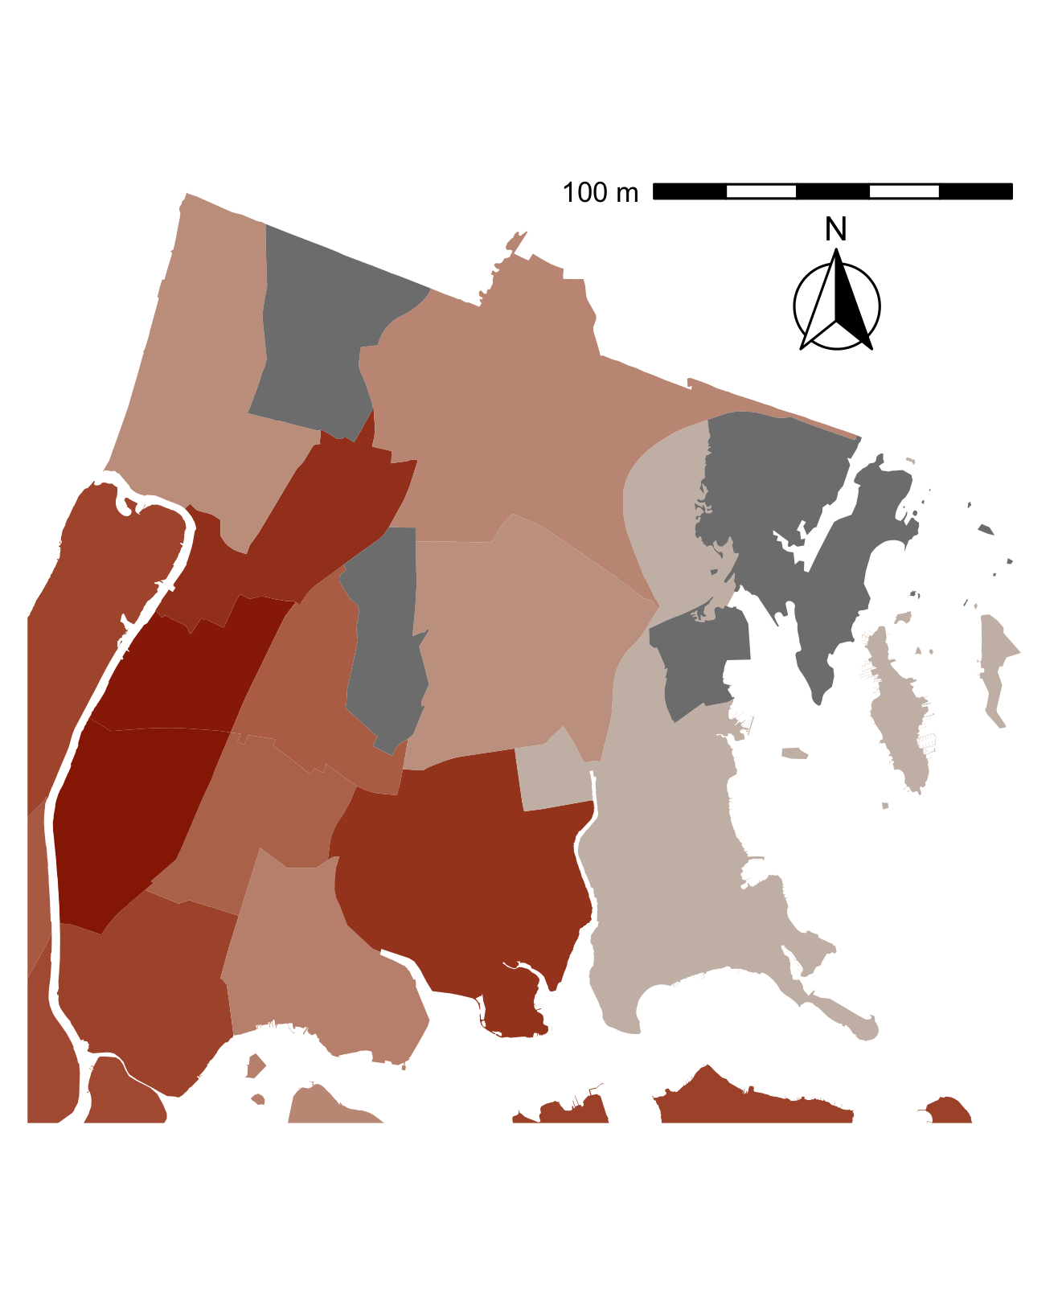
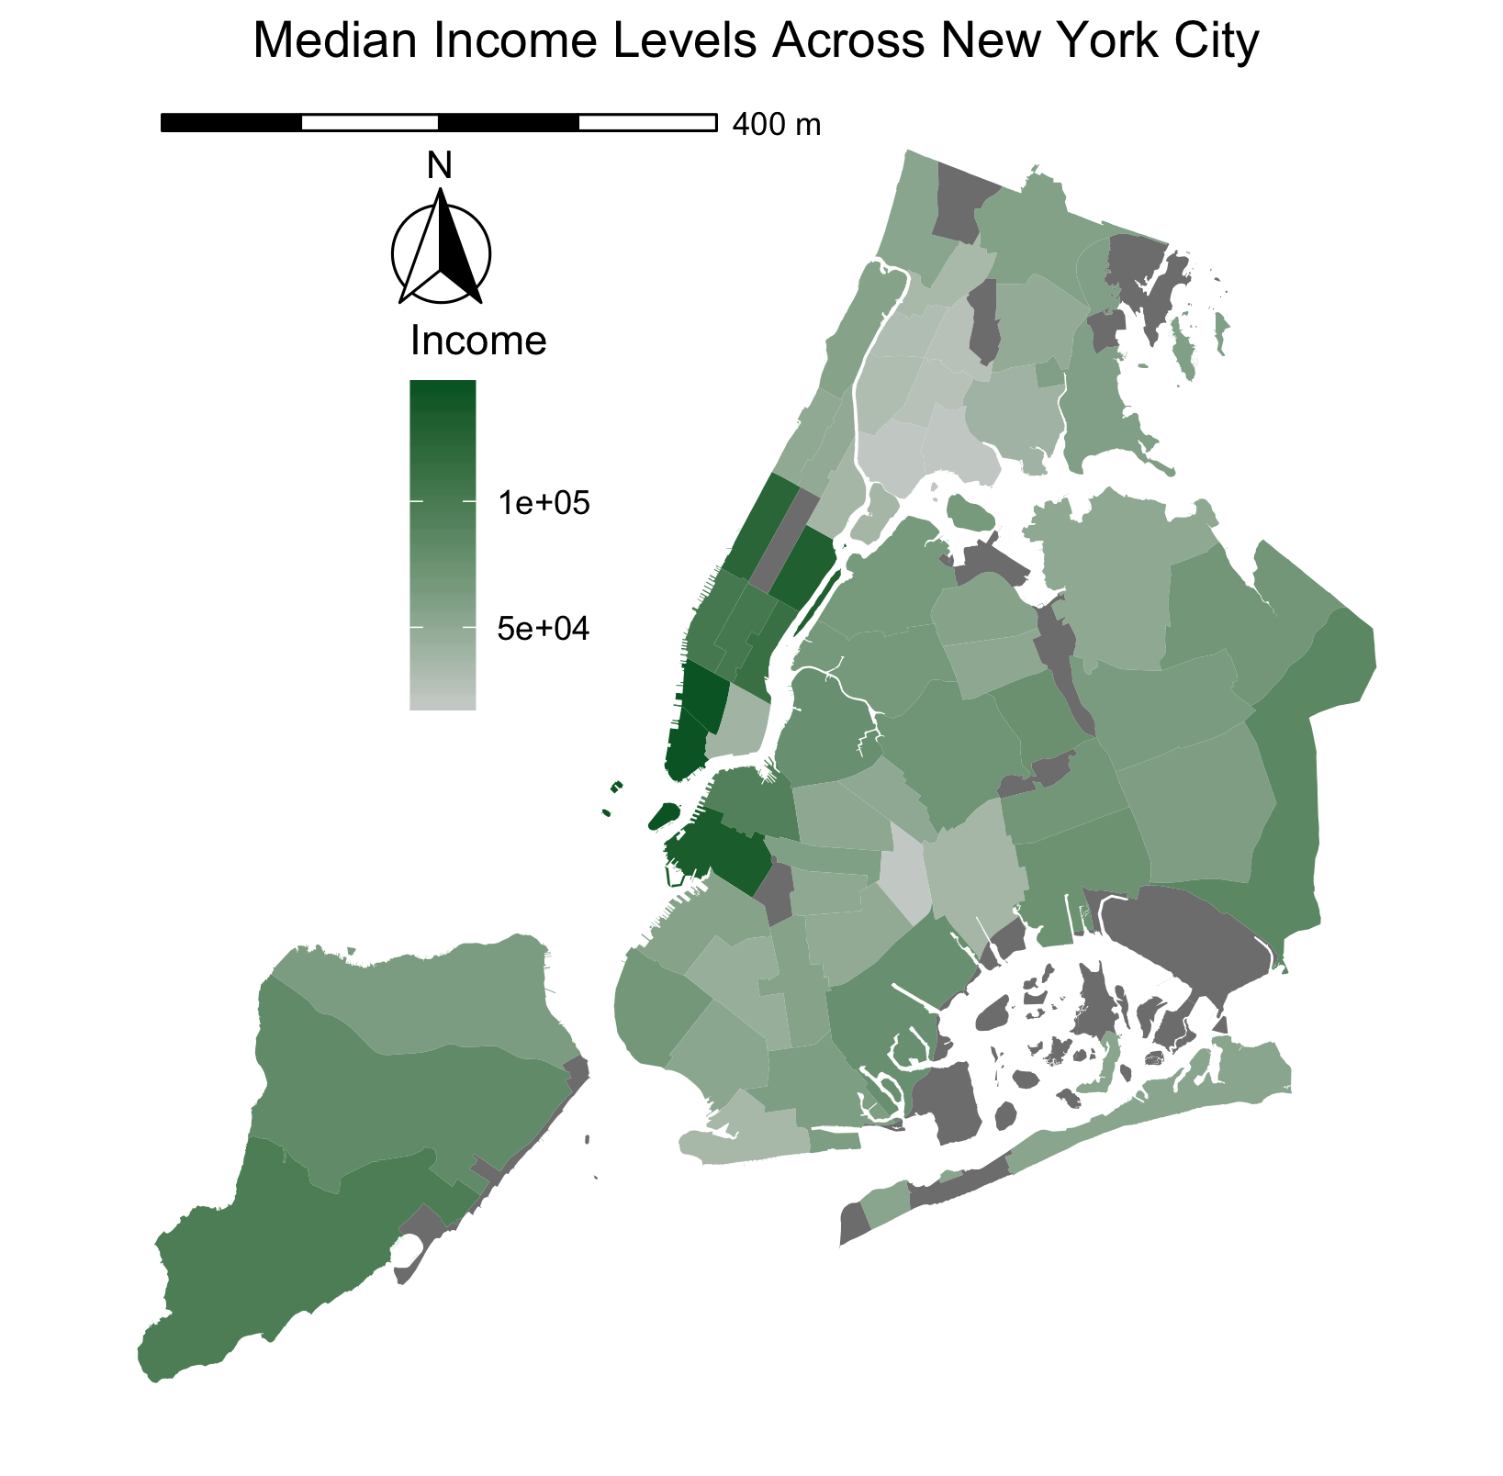




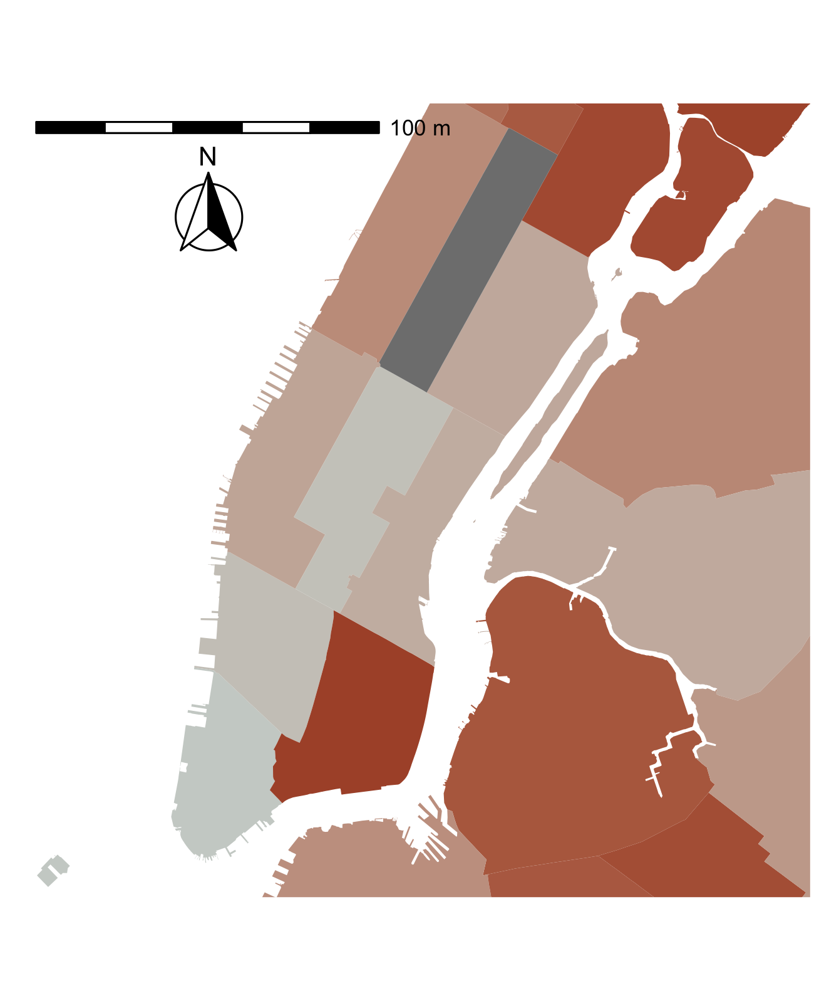
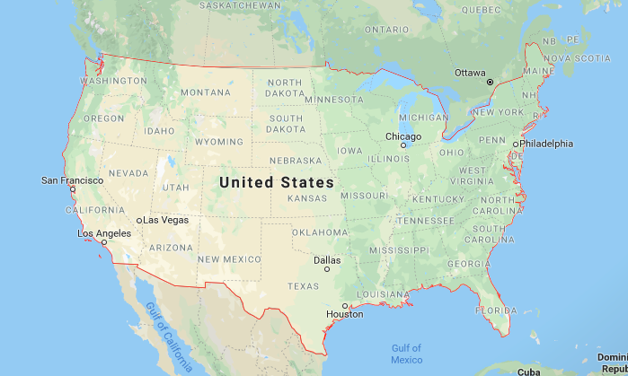
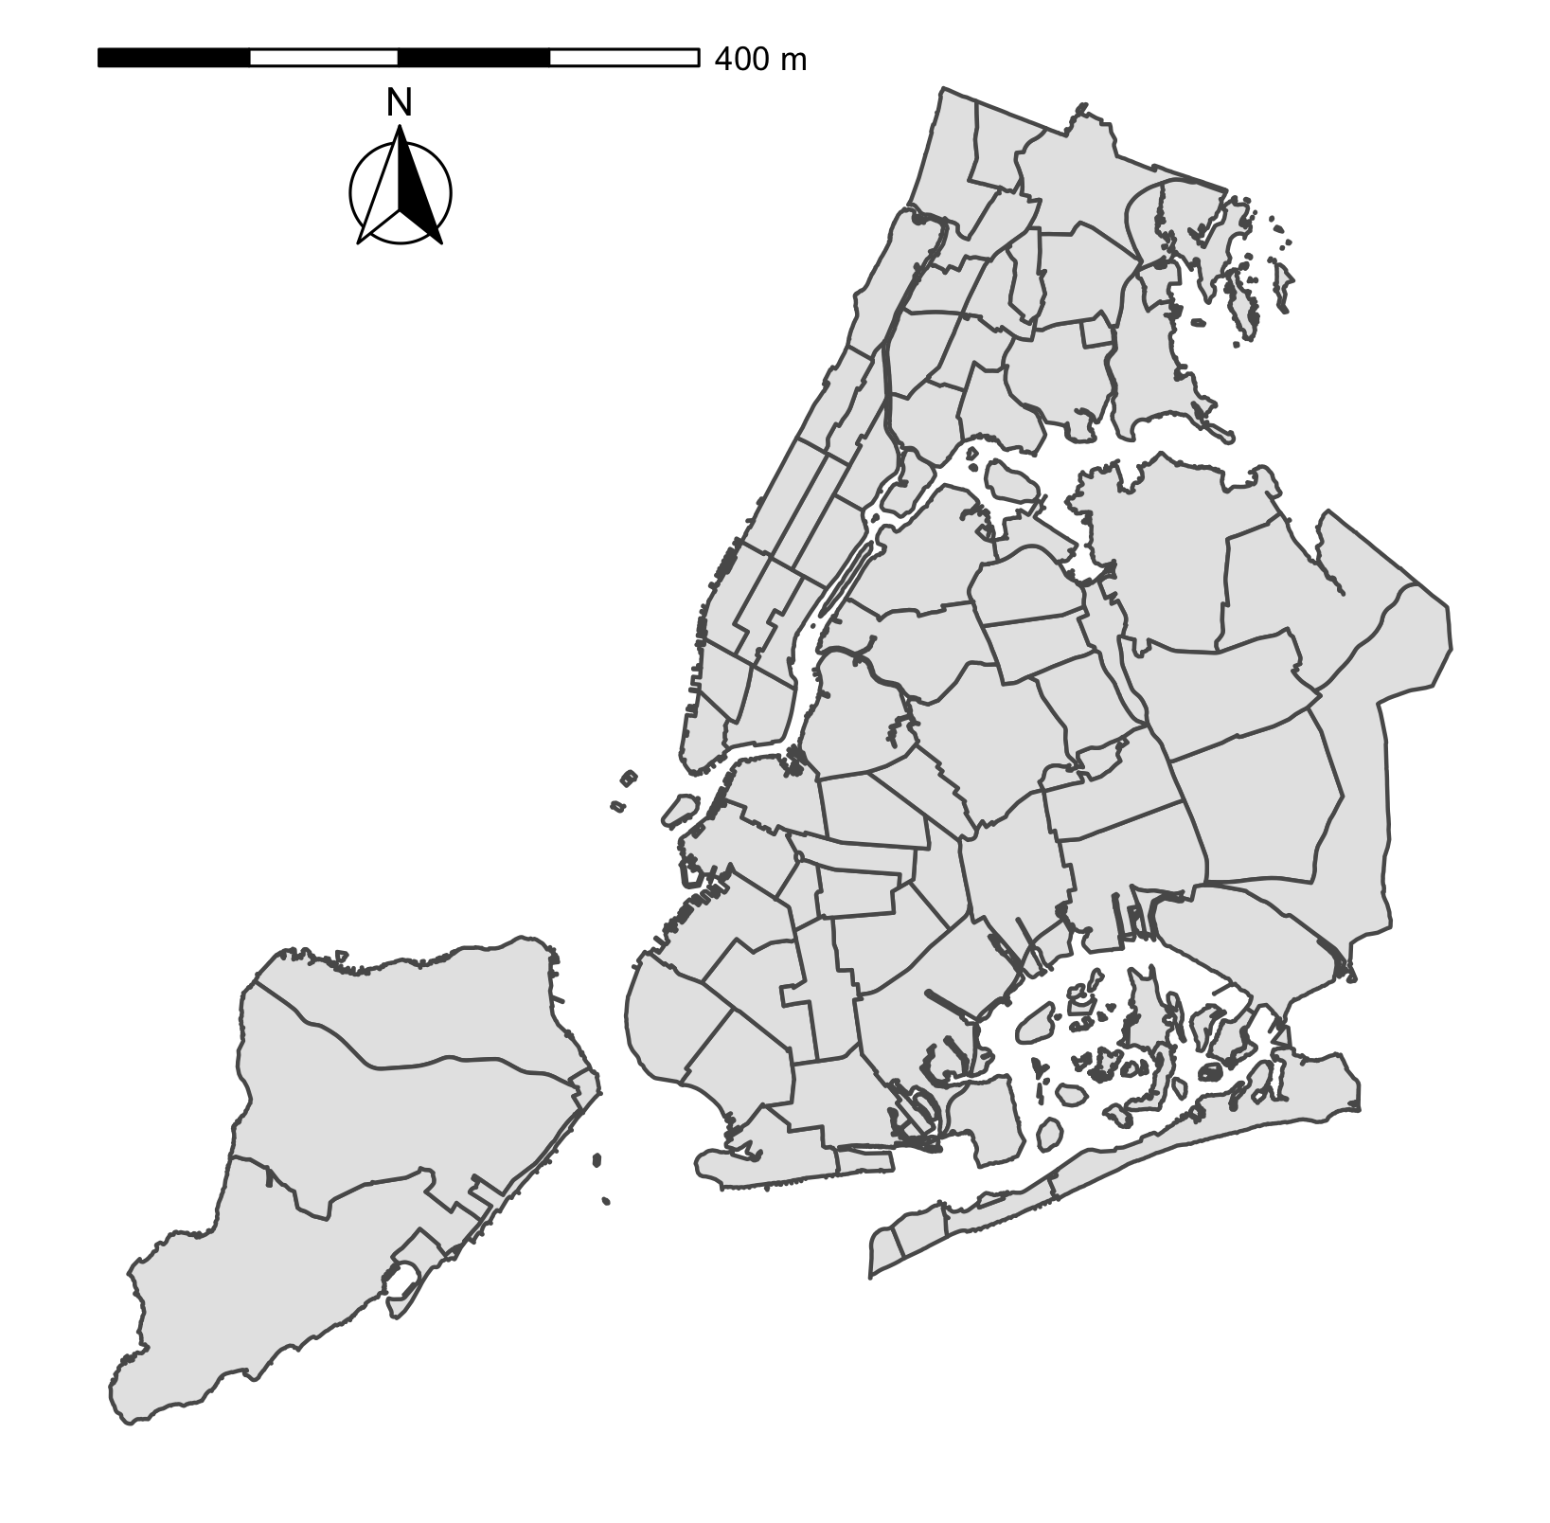
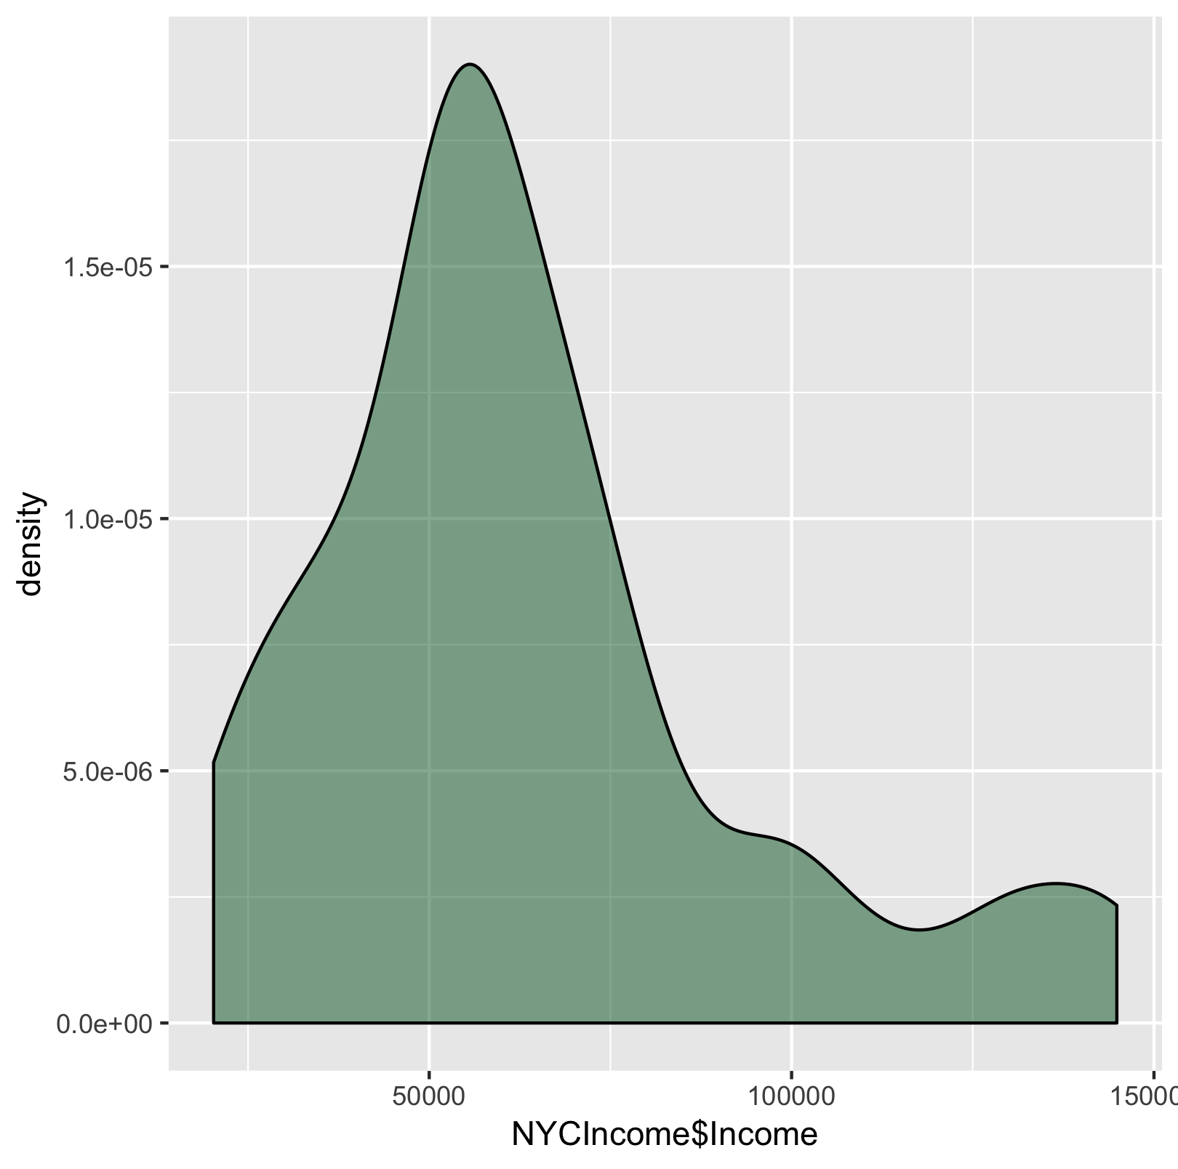
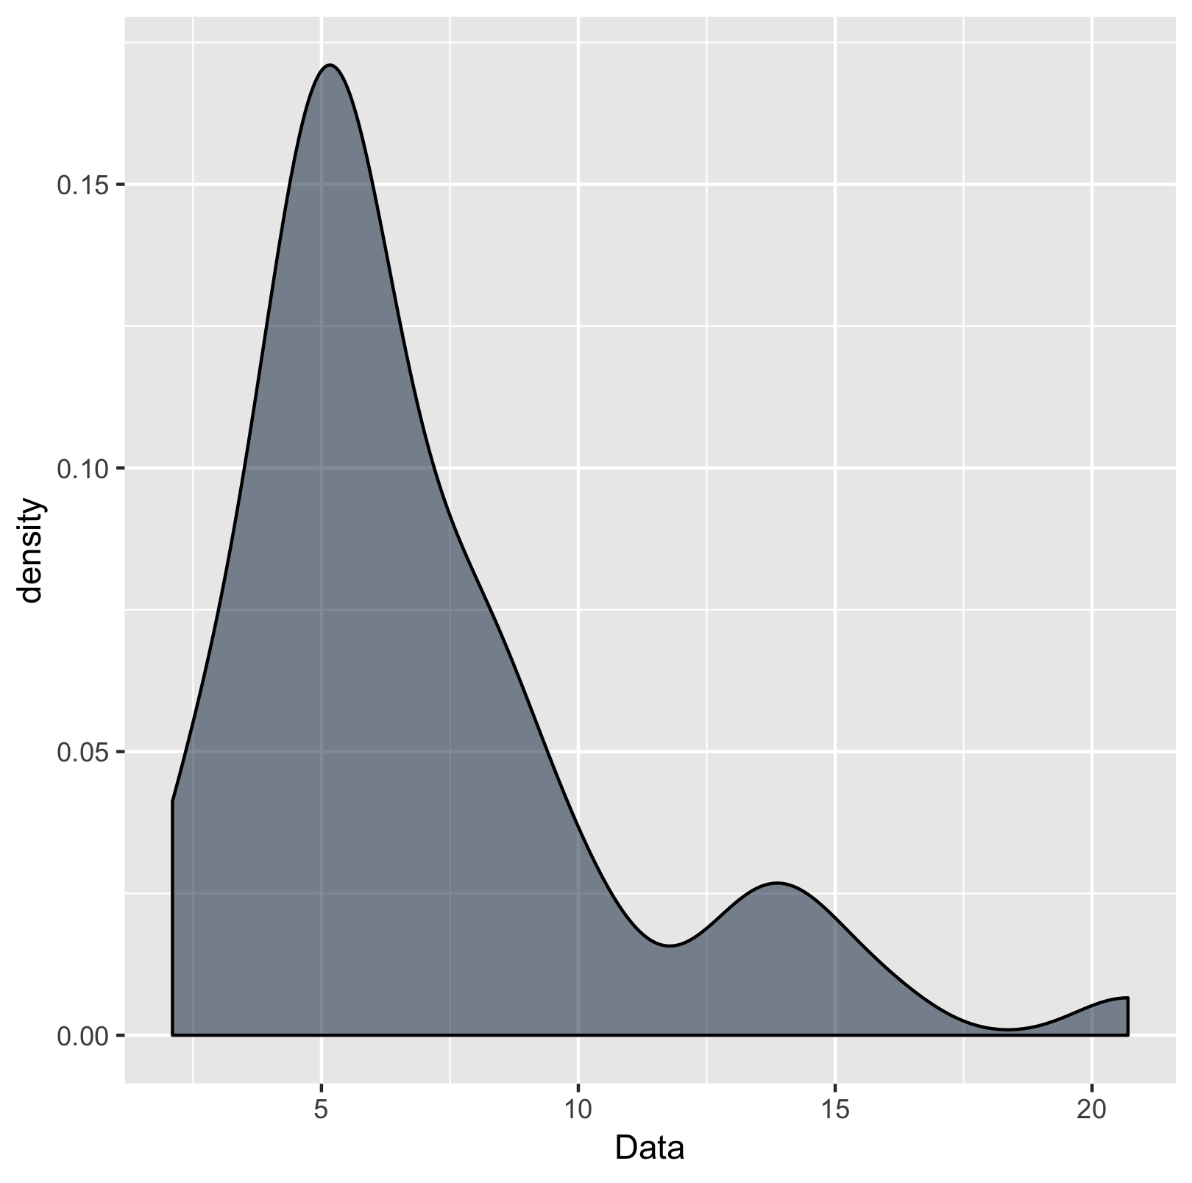
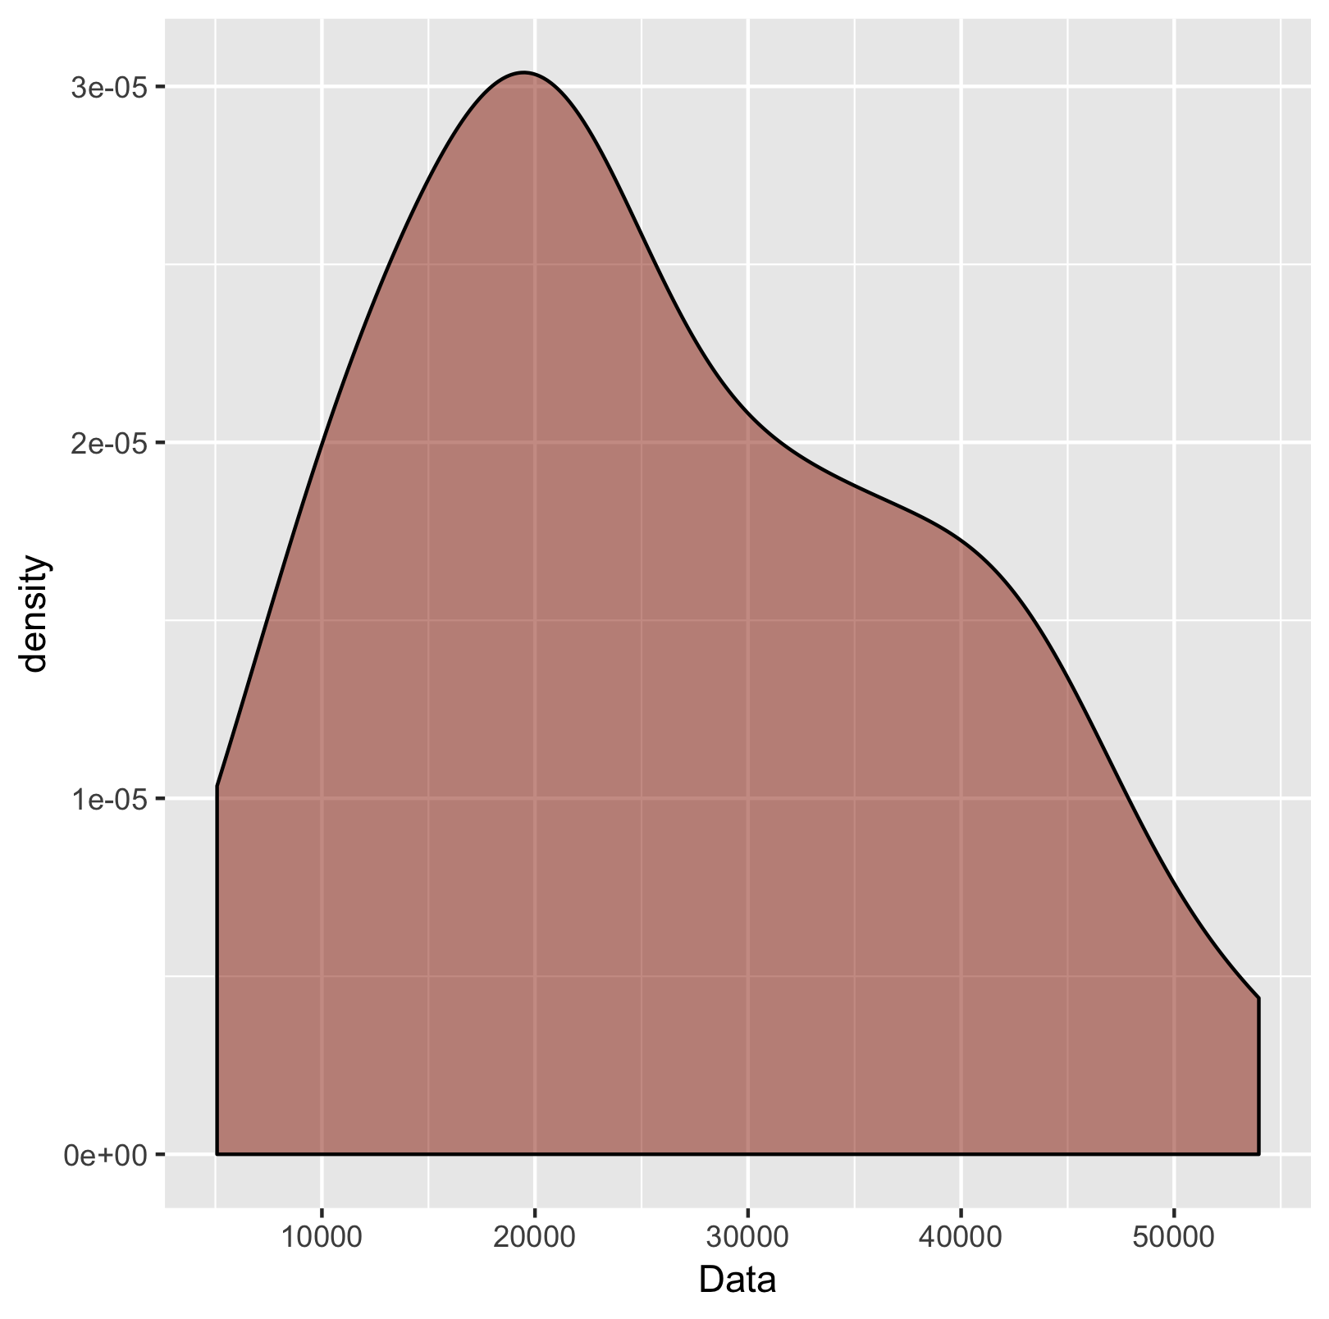
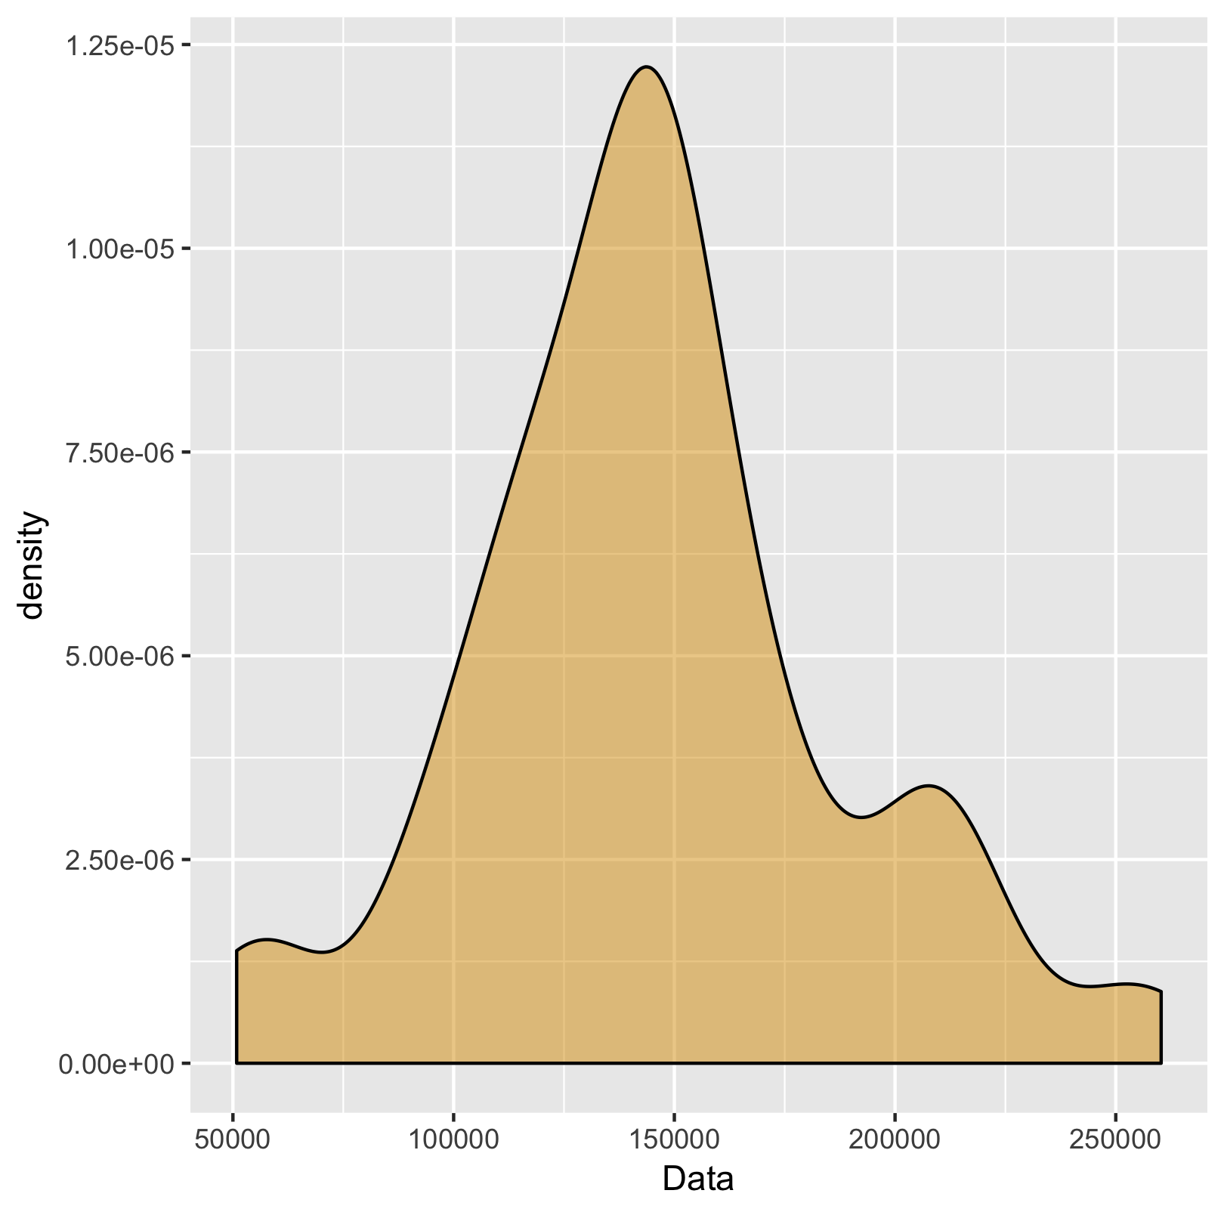
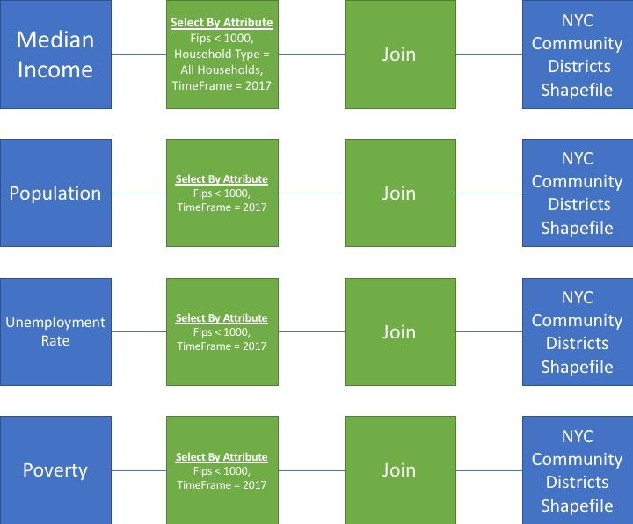
An Interdisciplinary Approach of Observing Quality of Life Indicators In an Urban Environment using Geographic Information Systems
Kamal Abdelrahman^{1,1}, Stephanie Rodriguez, MS^{1,2}
City University of New York – Brooklyn College¹
Department of Psychology¹, Department of Earth and Environmental Sciences²
Abstract
The Disparities
New York City is an urban area which provides of a multitude of services that support an adequate balance of “...biophysical, environmental and social conditions...” (Papageorgia, 1976) contributing to quality of life for New Yorkers. A Geographic Information Systems (GIS) choropleth and descriptive analysis will be used to link geographic trends between job availability, efficient transport systems, pollution, housing quality (Pacione, 2003), and education as factors pertinent to quality of life in the area. Datasets will be derived from multiple open-source data platforms, where each dataset will represent a quality of life indicator. Potential findings will support the importance of using various spatial datasets together to gain a greater insight on the influential factors contributing to quality of life. Information derived from the study can be used to identify policy planning in various urban areas across the United States.
Inter-Faceted Data
Figure 1: Examining quality of life through unemployment, poverty, income, and population
Study Area
Figure 2: Poverty levels appear significantly low in lower Bronx ,
high in lower Manhattan
Findings and Future Goals
Figure 2: Focusing on New York City on the community district level, balance between granularity and information of census and boroughs
Power in open sourced analysis, data and programming, of open sourced data for individuals who lack the resources to collect and analyze it, and still maintain a sense of participation. (Obermeyer, 1998)
Limitations
Very little flexibility with analysis of aggregated values
Small sample size to optimally support suggestable assumptions
Future Goals
Predictive models on analysis to identify future needs within communities
Explore analysis on a more granular level, potentially with the census tracts
GIS Model
Figure 3: There is a clear indication of disparity across quality of life factors; income, unemployment rate, poverty, and population (left to right
kamalabdel97
Kamal Abdelrahman
kamalabdel97@gmail.com

